Slide 1

INTRODUCTION TO R PROGRAMMING
MSBA Boot Camp Summer 2024
Instructor: Dr. Shengjun Mao
| 1

Slide 2
About Me
Dr. Shengjun Mao(毛聲俊)
Email: maosj@hku.hk
Office: KK 813, K.K. Leung Building
PhD from University of California, Irvine
Area: Information Systems
Research Interest: Online platforms, Digital Economy, Mobile apps, Gamification etc.
Teaching philosophy: Sharing things that you have learned earlier than others.

Slide 3
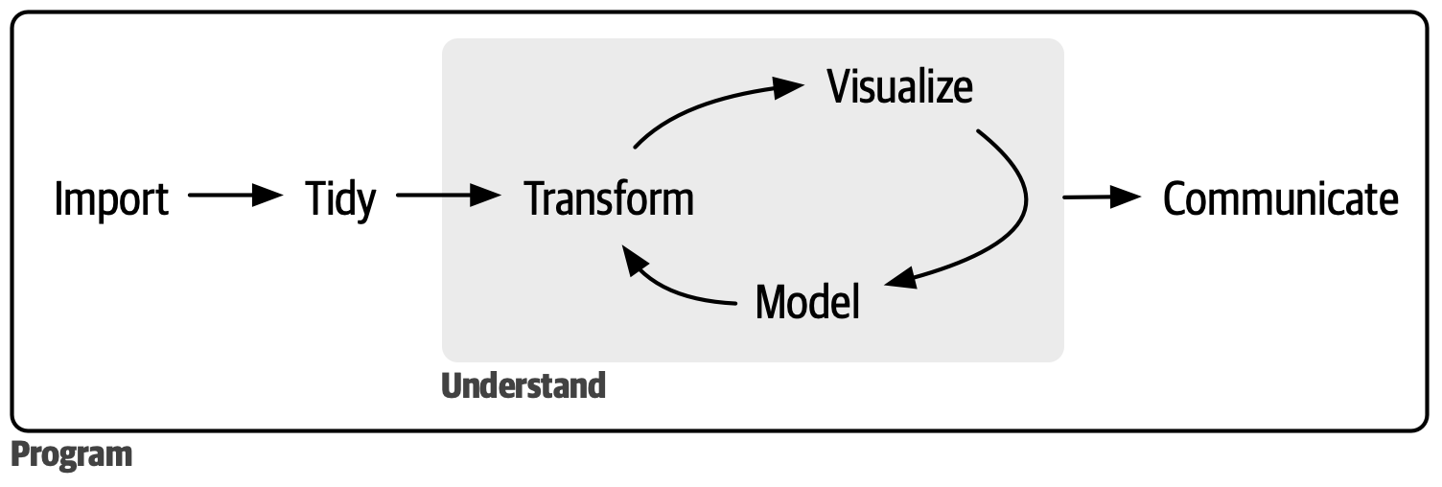
R
R is designed to help scientists analyze data
It is open source and free to use
It has many excellent functions that make plots and fit models to data.
Powerful in manipulating, visualizing, and modeling data

Slide 4
LEARNING OBJECTIVES
Learn R and RStudio
Basic Operation and Data Types
Basic operations (arithmetic, rational, logical etc.)
Atomic data types (integer, numeric, logical, character)
Vector
Matrix
List
Factor
Data frame
Data Manipulation
dplyr
Data Visualization
ggplot2
Functions and Flow Control Structure

Slide 5
R and RStudio
Download and Install R
Download the corresponding version of R from Comprehensive R Archive Network (CRAN) mirrors https://cran.r-project.org/mirrors.html
Choose “KoDDoS in Hong Kong” mirror under “China” at: https://mirror-hk.koddos.net/CRAN/
Download the corresponding version
Install R following the instructions.
Download and Install RStudio
RStudio is an integrated development environment (IDE) for R
Download RStudio at https://posit.co/products/open-source/rstudio/
Install RStudio following the instructions.
Open RStudio

Slide 6
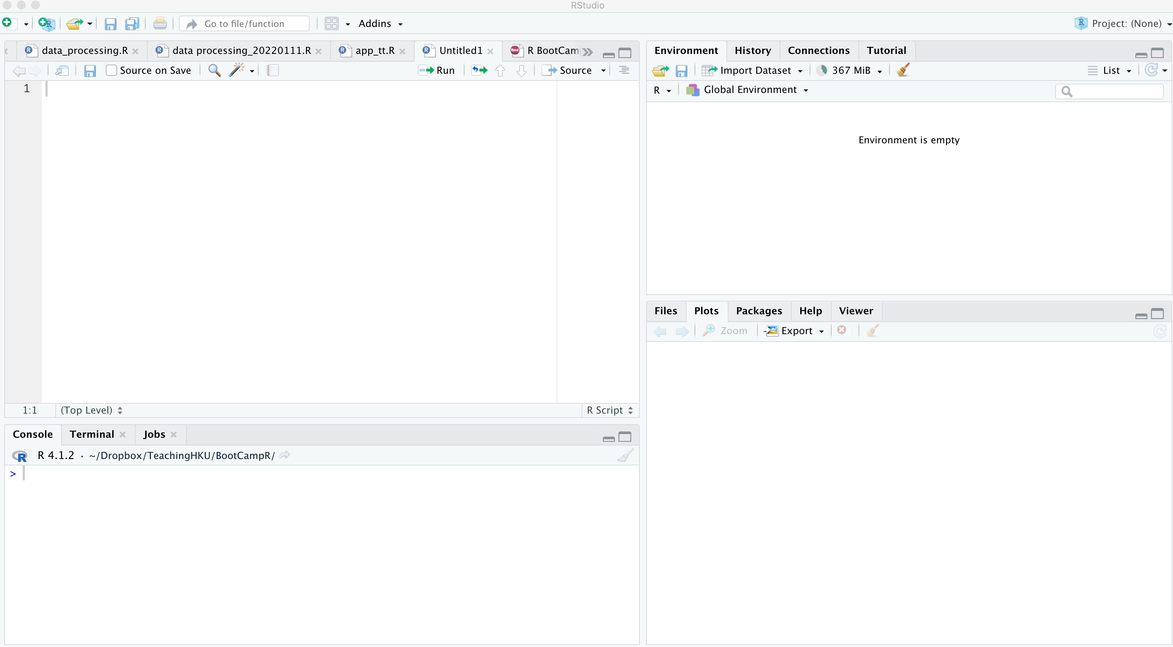




R STUDIO INTERFACE
R scripts,
Notebook, Markdown
Environment History etc.
Files, plot, Documentations, Packages …
Console Terminal

Slide 7
HOW TO LEARN CODING?
Two coding skills
How to code ((almost) the rest slides of this lecture notes)
How to learn to code (this slide)
Learning by understanding, not memorizing
Learning by searching, not memorizing
Learning by practicing, not memorizing
Helpful tutorials
R interactive tutorial in R (swirl package)
R official manuals at https://cran.r-project.org/manuals.html
Hands-On Programming with R by Garrett Grolemund
at https://rstudio-education.github.io/hopr/
R for Data Science (2e) by Hadley Wickham, Mine Çetinkaya-Rundel, and Garrett Grolemund.
at https://r4ds.hadley.nz/
YouTube video course at https://www.youtube.com/watch?v=Q5g6lYUn6Q4
Many many more…

Slide 8
SIMPLE OPERATIONS
| 12

Slide 9
SIMPLE OPERATIONS
Arithmetic Operators
Operator | Meaning | Example | Return
+ | Addition | 2 + 3 | 5
- | Subtraction | 2 - 3 | -1
* | Multiplication | 2 * 3 | 6
/ | Division | 2 / 3 | 0.6666667
^ or ** | Exponential | 2 ^ 3 or 2 ** 3 | 8
%% | Modulus (remainder) | 2 %% 3 | 2
%/% | Interger division | 2 %/% 3 | 0

Slide 10
SIMPLE OPERATIONS
Relational and logical Operators
Operator | Meaning | Example | Return
< | less than | 3 < 0 | FALSE
<= | less than or equal to | 3 <= 0 | FALSE
> | greater than | 3 > 0 | TRUE
>= | greater than or equal to | 3 >= 0 | TRUE
== | equal to | 3 == 0 | FALSE
!= | not equal to | 3 != 0 | TRUE
! | not | !0 !3 | TRUE FALSE
| | or | 3 | 0 | TRUE
& | and | 3 & 0 | FALSE
In R, numerical values other than 0 are treated as TRUE.
TRUE will be converted to the integer as 1 while FALSE to 0.
true and false are written as TRUE (T) and FALSE (F).

Slide 11

SIMPLE OPERATIONS
Quiz 1
Arithmetic, relational and logical operators
What do the following expressions return?
3/2
[1] 1.5
3 | 0
[1] TRUE
5 %/% 2
[1] 2
-2 & 5.0
[1] TRUE
7 %% 2
[1] 1
!!-9
[1] TRUE
TRUE | FALSE
[1] TRUE
3 - TRUE
[1] 2

Slide 12
Variable and Assignment operators
If you want to store the numbers and results for using again, store them in variables.
Variables are reserved memory locations to store values
i.e when we create a variable we allocate some memory space.
Variables are just names that you can use to call up stored data
Valid variable names
Almost everything (case sensitive)
with a few rules
Cannot start with a number
Cannot use some special symbols ^, !, $, @, +, -, /, * etc.
Valid: a, data1, my_data, abc.sum
Invalid: 1a, $xyz, _count

Slide 13
Variable and Assignment operators
Assignment operator <- and =
<- can be used anywhere for assignment,
= is only for assignment at the top level.
In the command prompt, x <- 5 is equivalent to x = 5
However, mean(x <- 1:5) is not equivalent to mean(x = 1:5)
mean(x <- 1:5) returns 3 and defines the variable x in the environment
mean(x = 1:5) returns 3 but does not define the variable x in the environment.

Slide 14
SIMPLE OPERATIONS
Data types
Atomic Classes | Example | Verify classes | Operations
integer | 4L | is.integer() | Arithmetic, relational operations etc.
numeric (real number) | 1, 2.3, Inf | is.numeric() is.infinite() is.double() | as.numeric() as.double()
complex | 2 + 0i | is.complex() | Arithmetic operations etc.
character | "I love BA", "3.8" | is.character() | relational, paste, find, match etc.
logical (boolean) | TRUE, FALSE and NA | is.logical() is.na() | logical, arithmetic etc.
Check the type of variables using
class()
x <- pi
class(x)
[1] "numeric"

Slide 15
VECTOR
| 20

Slide 16
CREATE A VECTOR
Vectors are sequence of data elements of the same data type (vectors are homogeneous).
num_vector <- c(1, 2, 3)
num_vector
[1] 1 2 3
new_vec <- c(1, "2", FALSE)
new_vec
[1] "1" "2" "FALSE"
class(num_vector)
[1] "numeric"
new_vec <- c(7, NA, FALSE)
new_vec
[1] 7 NA 0
More on coercion later!
is.vector(num_vector)
[1] TRUE
is.logical(c(7, NA, FALSE))
[1] FALSE
is.numeric(num_vector)
[1] TRUE
NA is logical
is.logical(c(NA, FALSE))
[1] TRUE

Slide 17
COERCION
Atomic Classes | Explicit Coercion
numeric | as.character() as.logical()
character
logical (boolean) | as.numeric() as.character()
Numeric
Logical
Character
Implicit coercion rules
> as.logical(2.3)
[1] TRUE
> as.character(2)
[1] "2"
> as.numeric(TRUE)
[1] 1
> as.character(TRUE)
[1] "TRUE"
> c(1, "a", TRUE)
[1] "1" "a" "TRUE”
> c(3, TRUE, 1)
[1] 3 1 1

Slide 18
INITIALIZE A VECTOR
Initialize a vector – vector()
vector(length = 5)
[1] FALSE FALSE FALSE FALSE FALSE
> num_vector <- vector(mode = "numeric", length = 10)
> num_vector
[1] 0 0 0 0 0 0 0 0 0 0
Get the length of a vector – length()
length(num_vector)
[1] 10

Slide 19


NAME A VECTOR
Name the elements in a vector – names()
price <- c(5.3, 3.5, 6.7, 11.9)
price
[1] 5.3 3.5 6.7 11.9
fruits <- c("apple", "orange", "banana", "mongo")
names(price) <- fruits
price
apple orange banana mongo
5.3 3.5 6.7 11.9
Assign names to the elements
price <- c(apple = 5.3, orange = 3.5, banana = 6.7, mongo = 11.9)
Quiz – Is it syntactically correct?
price <- c(apple <- 5.3, orange <- 3.5, banana <- 6.7, mongo <- 11.9)
If so, what’s the difference?
How about this?
price <- c("apple" = 5.3, "orange" = 3.5, "banana" = 6.7, "mongo" = 11.9)

Slide 20
VECTOR ARITHMETICS
Computations are performed element-wise
A vector and a single value
daily_income <- c(Tom = 10, Jimmy = 23, Lucy = 17)
monthly_income <- daily_income * 30
monthly_income
Tom Jimmy Lucy
300 690 510
A vector and a vector
monthly_expenses <- c(200, 700, 350)
monthly_savings <- monthly_income - monthly_expenses
monthly_savings Tom Jimmy Lucy
100 -10 160

Slide 21
VECTOR ARITHMETICS
Computations are performed element-wise
Compare two vectors
c(1, 2, | 3) | c(TRUE, | NA, 0)
[1] FALSE | NA | TRUE
c(0, 1, 2) & c(7, 8, 9)
[1] FALSE TRUE TRUE
!c(0, 1, 2)
[1] TRUE FALSE FALSE

Slide 22
VECTOR SUBSETTING
Generate a numeric vector
vec <- sample(1:100, size = 10, replace = FALSE)
vec
[1] 59 94 41 35 47 3 9 82 77 22
name <- c("a", "b", "c", "d", "e", "f", "g", "h", "i", "j")
names(vec) <- name
vec
a b c d e f g h i j
59 94 41 35 47 3 9 82 77 22
Index | 1 | 2 | 3 | 4 | 5 | 6 | 7 | 8 | 9 | 10
Name | a | b | c | d | e | f | g | h | i | j
Value | 59 | 94 | 41 | 35 | 47 | 3 | 9 | 82 | 77 | 22

Slide 23


VECTOR SUBSETTING
Subsetting by indices
vec[1]
a
59
vec[c(3, 4, 5)]
c d e
41 35 47
same as vec[3:5], but different from vec[c(3, 5, 4)] !
vec[-1] #all but the first element
b c d e f g h i j
94 41 35 47 3 9 82 77 22
Unary operator ‘-’ means “exclude”
Index | 1 | 2 | 3 | 4 | 5 | 6 | 7 | 8 | 9 | 10
Name | a | b | c | d | e | f | g | h | i | j
Value | 59 | 94 | 41 | 35 | 47 | 3 | 9 | 82 | 77 | 22

Slide 24

VECTOR SUBSETTING
Subsetting by names
vec["a"] a
59
vec[c("c", "d", "e")] c d e
41 35 47
vec[-"a"] Error
Unary operator “-” does not work on names!
Index | 1 | 2 | 3 | 4 | 5 | 6 | 7 | 8 | 9 | 10
Name | a | b | c | d | e | f | g | h | i | j
Value | 59 | 94 | 41 | 35 | 47 | 3 | 9 | 82 | 77 | 22

Slide 25
VECTOR SUBSETTING
Subsetting by a logical vector
- The logical vector and vec have the same length
vec[c(T, F, F, F, T, T, F, T, F, F)]
a e f h
59 47 3 82
- The logical vector is shorter than vec - Recycling
vec[c(T, F)] #equivalent to vec[c(T, F, T, F, T, F, T, F, T, F)]
a c e g i
59 41 47 9 77
- The logical vector is longer than vec, and the exceeding digits contain TRUE – Appending NA
vec[c(T, F, F, F, T, T, F, T, F, F, T, T)]
a e f h <NA> <NA>
59 47 3 82 NA NA
Quiz
1. How to fetch values that are greater than 50?
vec[vec > 50]
2. How to fetch values whose names are after “e”?
vec[name > “e”]
Index | 1 | 2 | 3 | 4 | 5 | 6 | 7 | 8 | 9 | 10
Name | a | b | c | d | e | f | g | h | i | j
Value | 59 | 94 | 41 | 35 | 47 | 3 | 9 | 82 | 77 | 22

Slide 26
VECTOR RECYCLING
Exercise vector recycling
When two vectors of unequal lengths, R repeats the shorter vector until it is as long as the longer vector, and then do the calculation
What results do you expect?
vec + c(1:10)
vec + c(1:2)
vec + c(1:15)
Index | 1 | 2 | 3 | 4 | 5 | 6 | 7 | 8 | 9 | 10
Name | a | b | c | d | e | f | g | h | i | j
Value | 59 | 94 | 41 | 35 | 47 | 3 | 9 | 82 | 77 | 22

Slide 27
MATRIX
| 31

Slide 28



CREATE MATRIX
Create a matrix using matrix()
matrix(1:6, nrow = 2)
 | [,1] | [,2] | [,3]
[1,] | 1 | 3 | 5
[2,] | 2 | 4 | 6
equivalent to matrix(1:6, ncol = 3)
matrix(1:6, nrow = 2, byrow = T)
 | [,1] | [,2] | [,3]
[1,] | 1 | 2 | 3
[2,] | 4 | 5 | 6
byrow controls the filling directions
byrow=F filled by columns
byrow=T filled by rows
matrix(1:3, nrow = 2, ncol = 3)
 | [,1] | [,2] | [,3]
[1,] | 1 | 3 | 2
[2,] | 2 | 1 | 3
recycling

Slide 29


CREATE MATRIX
Combine matrices using rbind() and cbind()
rbind(1:3, 2:4)
 | [,1] | [,2] | [,3]
[1,] | 1 | 2 | 3
[2,] | 2 | 3 | 4
rbind(): binding vectors or matrices by rows
m <- matrix(1:6, nrow = 2)
cbind(m, 98:99)
cbind(): binding vectors or matrices by columns
 | [,1] | [,2] | [,3] | [,4]
[1,] | 1 | 3 | 5 | 98
[2,] | 2 | 4 | 6 | 99

Slide 30
CREATE MATRIX
Retrieve or set the dimension – dim()
> | m <- 1:10
> | dim(m) <- c(2, 5)
> | m
 | [,1] | [,2] | [,3] | [,4] | [,5]
[1,] | 1 | 3 | 5 | 7 | 9
[2,] | 2 | 4 | 6 | 8 | 10
> > | x <- 1:10 attr(x,"dim") |  |  | <- c(2, 5)
> | x
 |  | [,1] | [,2] | [,3] | [,4] | [,5]
[1,] |  | 1 | 3 | 5 | 7 | 9
[2,] |  | 2 | 4 | 6 | 8 | 10

Slide 31



NAMES OF ROWS AND COLUMNS
Get or set row names and columns using rownames() and colnames()
m <- matrix(1:6, nrow = 2)
rownames(m) <- c('row1','row2')
colnames(m) <- c('col1', 'col2', 'col3')
m
Functions
Naming rows and columns after
defining the matrix
 | col1 | col2 | col3
row1 | 1 | 3 | 5
row2 | 2 | 4 | 6
Alternatively using attribute dimnames
n <- matrix(1:6, nrow = 2,
dimnames = list(c('row1', 'row2'),
c('col1', 'col2', 'col3')))
Argument Naming rows and columns when defining the matrix
n | col1 | col2 | col3
row1 | 1 | 3 | 5
row2 | 2 | 4 | 6
Naming for other R objects follows similar ways

Slide 32


MATRIX INDEXING AND SUBSETTING
m <- matrix(sample(20, 12), nrow = 3)
m
 | [,1] | [,2] | [,3] | [,4]
[1,] | 1 | 11 | 20 | 19
[2,] | 18 | 17 | 12 | 9
[3,] | 7 | 14 | 8 | 5
How to access the value 19 (up-right corner) in the matrix?
m[1,4]
[1] 19
row index first!
m[10] [1] 19
 | 1[1] 11[4] | 20[7] | 19[10]
 | 18[2] 17[5] | 12[8] | 9[11]
 | 7[3] 14[6] | 8[9] | 5[12]

Slide 33


MATRIX INDEXING AND SUBSETTING
m <- matrix(sample(20, 12), nrow = 3)
m
 | [,1] | [,2] | [,3] | [,4]
[1,] | 1 | 11 | 20 | 19
[2,] | 18 | 17 | 12 | 9
[3,] | 7 | 14 | 8 | 5
How to obtain the second row of the matrix?
m[2,]
[1] 18 17 12 9
Obtain a subset of the matrix
m[1:2, 1:3]
 | [,1] | [,2] | [,3]
[1,] | 1 | 11 | 20
[2,] | 18 | 17 | 12
Mind the difference
m[2]
[1] 18
How to obtain the second column of the matrix?
m[,2]
[1] 11 17 14
Quiz
What is m[c(1,3), 2] and
m[,c(4,3)] ?

Slide 34
MATRIX ARITHMETICS
Element-wise!
m
Sum over rows and columns – rowSums()
and colSums()
 | [,1] | [,2] | [,3] | [,4]
[1,] | 1 | 11 | 20 | 19
[2,] | 18 | 17 | 12 | 9
[3,] | 7 | 14 | 8 | 5
rowSums(m)
[1] 51 56 34
colSums(m)
[1] 26 42 40 33
m/10
[,1] [,2] [,3] [,4]
[1,] | 0.1 | 1.1 | 2.0 | 1.9
[2,] | 1.8 | 1.7 | 1.2 | 0.9
[3,] | 0.7 | 1.4 | 0.8 | 0.5
(m | / 10) | + (m | + 1)
 | [,1] | [,2] | [,3] | [,4]
[1,] | 2.1 | 13.1 | 23.0 | 21.9
[2,] | 20.8 | 19.7 | 14.2 | 10.9
[3,] | 8.7 | 16.4 | 9.8 | 6.5
How about means over rows and columns?
rowMeans(), colMeans()

Slide 35

MATRIX ARITHMETICS
Multiplications
x<-matrix(c(3,4,-2,6),nrow=2,byrow=T)
x
 | [,1] | [,2]
[1,] | 3 | 4
[2,] | -2 | 6
Element-wise multiplication
x * x
 | [,1] | [,2]
[1,] | 9 | 16
[2,] | 4 | 36
Element-wise multiplication: *
Matrix multiplication: %*%
Matrix multiplication
x %*% x
 | [,1] | [,2]
[1,] | 1 | 36
[2,] | -18 | 28

Slide 36
MATRIX FUNCTIONS
Matrix transpose – t()
t(m)
Inverse of a matrix – solve()
dim(x)
[1] 2 2
 | [,1] | [,2] | [,3]
[1,] | 1 | 18 | 7
[2,] | 11 | 17 | 14
[3,] | 20 | 12 | 8
[4,] | 19 | 9 | 5
solve(x) %*% x
[,1]
[,2]
[1,] | 1 | -1.110223e-16
[2,] | 0 | 1.000000e+00
R can also deal with n-dimensional array by array(), which will not introduce in this bootcamp. Feel free to explore more.

Slide 37
FACTOR
| 51

Slide 38



CREATE FACTORS
Factors – Categorical variables
blood <- c('AB', 'A', 'A', 'O', 'B', 'O')
class(blood)
[1] "character"
> blood_factor <- factor(blood)
> blood_factor
[1] AB A A O B O
Levels: A AB B O
class(blood_factor)
[1] "factor"
as.numeric(blood_factor)
[1] 2 1 1 4 3 4
attr(blood_factor,"levels")
[1] "A" "AB" "B" "O"
Function factor() encodes vectors to factors
By default, Levels sorted alphabetically
Another way to think of factors is integers that have labels.

Slide 39

MANIPULATING FACTORS
To inspect the structure of a factor - str()
str(blood_factor)
Factor w/ 4 levels "A","AB","B","O": 2 1 1 4 3 4
Recall
blood_factor
[1] AB A A O B O
Levels: A AB B O
A | 1
AB | 2
B | 3
O | 4
AB | 2
A | 1
A | 1
O | 4
B | 3
O | 4
Knowing levels of factors is important, because it is important in data analysis to know which class is used as the baseline level
Reorder levels
blood_factor <- factor(blood, levels = c('O', 'A','B', 'AB'))
str(blood_factor)
Factor w/ 4 levels "O","A","B","AB": 4 2 2 1 3 1

Slide 40

RENAME FACTOR LEVELS
Set or get levels – levels()
levels(blood_factor) <- c('BT_O', 'BT_A', 'BT_B', 'BT_AB')
blood_factor
[1] BT_AB BT_A BT_A BT_O BT_B BT_O
Levels: BT_O BT_A BT_B BT_AB
Set or get labels – labels()
factor(blood, labels = c('BT_A', 'BT_AB', 'BT_B', 'BT_O’))
[1] BT_AB BT_A BT_A BT_O BT_B BT_O
Levels: BT_A BT_AB BT_B BT_O
Mind the order of labels corresponding to levels, or it will be extremely confusing!
A good practice – Define levels and labels explicitly
factor(blood,
+
+
levels = c('O', 'A', 'B', 'AB'),
labels = c('BT_O', 'BT_A', 'BT_B', 'BT_AB'))
[1] BT_AB BT_A BT_A BT_O BT_B BT_O
Levels: BT_O BT_A BT_B BT_AB

Slide 41

NOMINAL VERSUS ORDINAL
Factors, or categorical variables usually are nominal and can’t be numerically compared nor follow a specific order.
However, in some cases, ordinal levels are desired, we can either convert the factor as numeric or use order
tshirt <- c("M", "S", "M", "L", "L", "S")
tshirt_factor <- factor(tshirt, ordered = T, levels = c('S', 'M', 'L’))
tshirt_factor
[1] M S M L L S
Levels: S < M < L
tshirt_factor[2] > tshirt_factor[1]
[1] FALSE
ordered = TRUE tell factor() that the levels follow ascending order

Slide 42
LIST
| 42

Slide 43

CREATE A LIST
Recall that vectors and matrices can only contain elements of the same class
c('A+', 4.3, 'A', 3.9)
[1] "A+" "4.3" "A" "3.9"
Coercion occurs!
Lists are a special type of vector that can contain elements of different classes
grade <- list('A+', 4.3, 'A', 3.9)
grade [[1]]
[1] "A+"
[[2]]
[1] 4.3
[[3]]
[1] "A"
[[4]]
[1] 3.9
Quiz!
Is this a valid?
list('A+', 4.3, c(4.3, '4’))
How about
list(100:130, "R", list(TRUE, FALSE))

Slide 44

LIST INDEXING AND SUBSETTING
[Ex] Difference between [[]] and []
grade[2]
[[1]]
[1] 4.3
grade[[2]]
[1] 4.3
Observe:
What are the formats and classes of returned objects?
[] returns a list element
[[]] returns the content of an element in the list
class(grade[2])
[1] "list"
class(grade[[2]])
[1] "numeric"
list [1]
list [2]
list [3]
…
List

Slide 45






LIST DATA STRUCTURE
[[2]]
[[1]]
[1]
[2]
[3]
Quiz!
What is [4] and [[4]] ?
[4]: The outermost box
[[4]]: The second outermost box (the content of the outermost box ([4]) is also a box!

Slide 46
LIST INDEXING AND SUBSETTING
Quiz – what is the output of the following statement?
x <- seq(from = 1, to = 10, by = 3) # 1 4 7 10
y <- rep(4, 3) # 4 4 4
z <- list(x, y)
z[c(1)]
z[c(1,3)]
z[[c(1,3)]]

Slide 47


LIST INDEXING AND SUBSETTING
Quiz – what is the output of the following statement?
z[c(1)]
[[1]]
[1] 1 4 7 10
Recall:
z [[1]]
[1] 1
4 7 10
z[c(1,3)]
[[1]]
[[2]]
[1] 4 4 4
[1] 1
[[2]] NULL
4 7 10
z[[c(1,3)]]
[1] 7
Equivalent to
z[[1]][3]
get the third element of the first element list

Slide 48

NAME A LIST
Get or set names: names()
names(grade) <- c('MSBA7001','MSBA7002','MSBA7003','MSBA7004')
grade
$MSBA7001
[1] "A+"
$MSBA7002
[1] 4.3
As covered before, naming matrices also comes with two ways: 1) function and 2) arguments
$MSBA7003
[1] "A"
$MSBA7004
[1] 3.9
grade <- list('MSBA7001' = 'A+', 'MSBA7002' = 4.3, 'MSBA7003' = 'A', 'MSBA7004' = 3.9)

Slide 49
LIST INDEXING AND SUBSETTING
Retrieve elements in a list using names with $
grade[[2]]
[1] 4.3
grade$MSBA7002
[1] 4.3
names(grade)
[1] "MSBA7001" "MSBA7002" "MSBA7003" "MSBA7004"

Slide 50

$ AND EXTENDING A LIST
$ only works for a named list!
grade$MSBA7001
[1] "A+"
Recall
grade
$MSBA7001
[1] "A+"
Extend a list
grade$comment <- 'This student is doing very well'
grade[['certificate']] <- 'First Honor'
grade[[8]] <- "4.0"
str(grade)
$MSBA7002
[1] 4.3
List of 8
$ MSBA7001 : chr "A+"
$ MSBA7002 : num 4.3
$ MSBA7003 : chr "A"
$ MSBA7004 : num 3.9
$ comment : chr "This student is doing very well"
$ certificate: chr "First Honor"
$ : NULL
$ : chr "4.0"
$MSBA7003
[1] "A"
$MSBA7004
[1] 3.9
NULL means empty

Slide 51
LIST SUBSETTING: PARTIAL MATCHING
Partial matching of name is allowed for $ and [[]]
grade[['co']]
NULL
grade
$MSBA7001
[1] "A+"
grade[['co', exact = FALSE]]
[1] "This student is doing very well"
$MSBA7002
[1] 4.3
grade$co
[1] "This student is doing very well"
$MSBA7003
[1] "A"
$MSBA7004
[1] 3.9
Use with caution!
$comment
[1] "This student is doing very well"
$certificate
[1] "First Hornor"

Slide 52
DATA FRAME
| 56

Slide 53
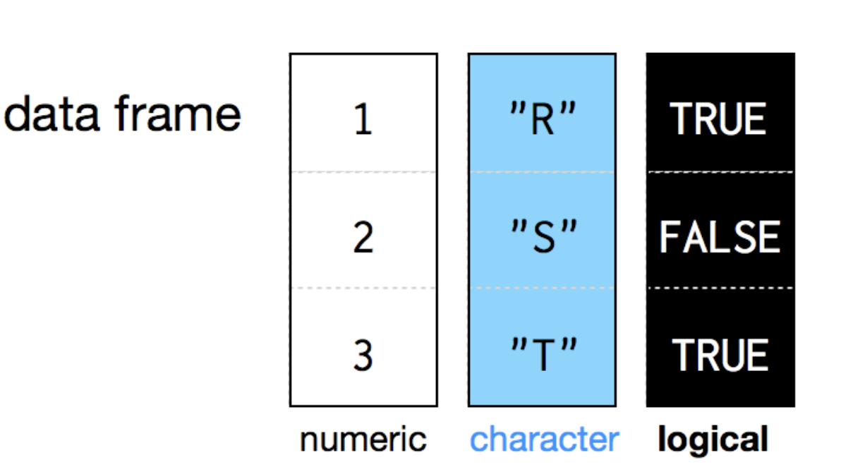

CREATE A DATAFRAME
Two-dimensional version of list
It groups vectors together into a 2D table
Each vector becomes a column in the table
Each column contains one and only one type of data
Unlike matrices, different columns can have different data types.

Slide 54
CREATE A DATAFRAME
Use data.frame() to create a data frame
name <- c('Lucy', 'Helen', 'Johnny', 'Jimmy', 'Victor', 'Hilda', 'Anthony')
age <- c(21, 23, 24, 22, 25, 21, 25)
attendance <- c(T, F, T, F, F, T, F)
df <- data.frame(name, age, attendance)
df
name age attendance
1 Lucy 21 TRUE
2 Helen 23 FALSE
3 Johnny 24 TRUE
4 Jimmy 22 FALSE
5 Victor 25 FALSE
6 Hilda 21 TRUE
7 Anthony 25 FALSE

Slide 55

EXAMINE DATA FRAMES
Set the structure – str()
str(df)
'data.frame': 7 obs. of 3 variables:
$ name : chr "Lucy" "Helen" "Johnny" "Jimmy" ...
$ age : num 21 23 24 22 25 21 25
$ attendance: logi TRUE FALSE TRUE FALSE FALSE TRUE ...
Get the summary statistics of the variables – summary()
summary(df)
name age attendance
Length:7 Min. :21.0 Mode :logical
Class :character 1st Qu.:21.5 FALSE:4
Mode :character Median :23.0 TRUE :3
Mean :23.0
3rd Qu.:24.5
Max. :25.0
Other handy functions:
dim(df)
[1] 7 3
nrow(df)
[1] 7
ncol(df)
[1] 3

Slide 56
EXAMINE DATA FRAMES
Get first rows of the data frame - head()
> head(df)
name age attendance
1 Lucy 21 TRUE
2 Helen 23 FALSE
3 Johnny 24 TRUE
4 Jimmy 22 FALSE
5 Victor 25 FALSE
Hilda 21 TRUE
Get the last rows of the data frame - tail()
> tail(df)
name age attendance
2 Helen 23 FALSE
3 Johnny 24 TRUE
4 Jimmy 22 FALSE
5 Victor 25 FALSE
6 Hilda 21 TRUE
7 Anthony 25 FALSE
If you want to see the whole data frame, use View(df), the data with be displayed in a separate view tab panel
Retrieve column/variable names - colnames() or names()
> colnames(df)
[1] "name" "age" "attendance”
> names(df)
[1] "name" "age" "attendance"
Retrieve row names rownames()
> rownames(df)
[1] "1" "2" "3" "4" "5" "6" "7"

Slide 57

SUBSET OF A DATA FRAME
Data frame is essentially a list
is.data.frame(df)
[1] TRUE
Therefore, subsetting a list also works in subsetting a data frame.
- Single index to access columns
df[3]
attendance
1 TRUE
2 FALSE
3 TRUE
4 FALSE
5 FALSE
6 TRUE
7 FALSE
is.list(df)
[1] TRUE
> | df
name |  | age | attendance
1 Lucy |  | 21 | TRUE
2 Helen |  | 23 | FALSE
3 Johnny |  | 24 | TRUE
4 Jimmy |  | 22 | FALSE
5 Victor |  | 25 | FALSE
6 Hilda |  | 21 | TRUE
7 Anthony |  | 25 | FALSE
df[[3]][2]
[1] FALSE
> df[[c(1,2)]]
[1] "Helen”
> df[[1,2]]
[1] 21
df[3][2]
Error in `[.data.frame`(df[3], 2) : undefined columns selected
Doesn’t work in a pure list, Caution!
Quiz
What will df[[3]]
return?

Slide 58

SUBSET OF A DATA FRAME
However, more often we use double index to access the row or column similar as a matrix
df[3,]
name age attendance
3 Johnny 24 TRUE
df[,3]
[1] TRUE FALSE TRUE FALSE FALSE TRUE FALSE
df[3, 'age'] #equivalent to df[3,2]
[1] 24
> df[c(1,3), c(1,2)]
name age
1 Lucy 21
3 Johnny 24
df
name age attendance
Lucy 21
Helen 23
Johnny 24
Jimmy 22
Victor 25
Hilda 21
25
TRUE FALSE TRUE FALSE FALSE TRUE FALSE
7 Anthony
What can you learn from the following results?
class(df[,3])
[1] "logical"
class(df[3,])
[1] "data.frame"
What is the output of
is.list(df[3,])

Slide 59


SUBSET OF A DATA FRAME
- Works for logical indexing too
df
name age attendance
Quiz
What is df[attendance,]?
Lucy 21
Helen 23
Johnny 24
TRUE FALSE TRUE
df[attendance,]
4 Jimmy | 22 | FALSE |  | name | age | attendance
5 Victor | 25 | FALSE | 1 | Lucy | 21 | TRUE
6 Hilda | 21 | TRUE | 3 | Johnny | 24 | TRUE
7 Anthony | 25 | FALSE | 6 | Hilda | 21 | TRUE
df[attendance, c('age', 'name')]
 | age | name
1 | 21 | Lucy
3 | 24 | Johnny
6 | 21 | Hilda
Pay attention to the order of columns

Slide 60
EXTEND A DATA FRAME
Get or add single columns using $
> df$name
[1] "Lucy" "Helen" "Johnny" "Jimmy" "Victor" "Hilda" "Anthony”
> df$age
[1] 21 23 24 22 25 21 25
df$height <- c(178, 189, 185, 165, 176, 167, 164)
> df
name age attendance height
1 Lucy 21 TRUE 178
2 Helen 23 FALSE 189
3 Johnny 24 TRUE 185
4 Jimmy 22 FALSE 165
5 Victor 25 FALSE 176
6 Hilda 21 TRUE 167
7 Anthony 25 FALSE 164

Slide 61


EXTEND A DATA FRAME
Add new columns using cbind()
> weight <- c(78, 89, 85, 65, 76, 67, 64)
> cbind(df, weight)
name age attendance height weight
1 Lucy 21 TRUE 178 78
2 Helen 23 FALSE 189 89
3 Johnny 24 TRUE 185 85
4 Jimmy 22 FALSE 165 65
5 Victor 25 FALSE 176 76
6 Hilda 21 TRUE 167 67
7 Anthony 25 FALSE 164 64
df does not change, because we did not assign the updated df to the original df object.
df <- cbind(df, weight)
Quiz
What will df look like after cbind(df, weight)

Slide 62
EXTEND A DATA FRAME
Add new rows – rbind()
charlie <- c("Charlie", 21, T, 183, 83)
rbind(df, charlie)
name age attendance height weight
1 Lucy 21 TRUE 178 78
2 Helen 23 FALSE 189 89
3 Johnny 24 TRUE 185 85
4 Jimmy 22 FALSE 165 65
5 Victor 25 FALSE 176 76
6 Hilda 21 TRUE 167 67
7 Anthony 25 FALSE 164 64
8 Charlie 21 TRUE 183 83

Slide 63
LOAD and SAVE DATA
Save data
write.csv(df, file = ”bootcamp_df.csv", row.names = FALSE)
Load data
Method 1: use RStudio “import dataset”, it automatically quote the command
> bootcamp_df <- read.csv("YourWorkSpaceDirectory/bootcamp_df.csv")
> View(bootcamp_df)
Method 2: manually write code (preferred and more often)
bootcamp_df <- read.csv(file = "bootcamp_df.csv", header = T, sep = ",")
> head(bootcamp_df)
name age attendance
1 Lucy 21 TRUE
2 Helen 23 FALSE
3 Johnny 24 TRUE
4 Jimmy 22 FALSE
5 Victor 25 FALSE
6 Hilda 21 TRUE

Slide 64
DPYLR - TBC
| 67

